Slide 1

Bhaktapur Multiple Campus
Affiliated to TU
Department of computer Science and information Technology
Dudhpati, Bhaktapur
Presentation on
Job-Station Job Recommendation System
Presented by:
Nabin Bhandari[20246/075]
2. Chetan Budhathoki[20232/075]
2. Bimal Shrestha[20227/075]
Date: 2080/01/23

Slide 2
Table of Content
Introduction
Problem statement
Objective
Scope and Limitation
Requirement Analysis
Process Model:
Dataflow Diagram
Flow Chart
ER Diagram
Implementation tool
Testing
Conclusion
Future Remediation

Slide 3
Introduction
Job Recommendation System” is a web application developed using php as a backend tool and html, CSS and JavaScript as a front end tool.
Uses the content based filtering approach to recommend the jobs by matching the employers requirements and job seekers qualifications,skills and experiences .
Employer can post the jobs with all the requirements including their details itself.
Job seeker can search for jobs manually, also , the system itself suggests the relevent jobs to the user.
The recommendation algorithm implemented here matches the employers requirements and job seekers qualifications, skills and experiences.

Slide 4
Problem statement
Loss of time in searching for the jobs and going to each company physically.
Companies have difficult time managing employee recruiting system and finding good employees.
It is not possible for the every job seeker to view the newspaper looking for jobs daily.
Some other problems related to employment are presented below:
People are not getting the job according to their qualification, experience, etc.
There is the problem of nepotism
There is a problem regarding the placement of the right person to right place

Slide 5
OBJECTIVE
The main objective of the job recommendation system is to recommend the job to job Seekers
Reduce traditional way of job searching
To improve job search efficiency.
To increase user engagement.
Enhance job matching accuracy.

Slide 6
Scope
1.This system is to be developed provides the members with job information, online applying for jobs and many other facilities
2.The job seekers can apply for the match jobs and search job as per hi/her requirement
3. Maintain job seeker and employer records.
4. Provide customized job postings.
5. Maintain job posting details.
6. Maintain the job applications lists.

Slide 7
Limitation
1. Data Scalability
2. Cold start Problems
3. Limited data 4. Inability to handle context.

Slide 8
Requirement Analysis
Requirement analysis is the process of analyzing, gathering, refining and documenting system requirements.
This requirements determine what the system should do.
The requirements are categorized into two types: Functional Requirements & Non Functional Requirements

Slide 9
Functional requirement:
Functional requirements are the specific features or capabilities that a system must have in order to fulfill its intended purpose. In the context of a job recommendation system, some possible functional requirements might include:

Slide 10
Job Seekers Module • Registration / Login • Apply for Job • Forgot Password • Search for Job vacancies • Update Profile • Logout • Send Feedback • View applied jobs

Slide 11
Employers Module
Registration
Login
View Job applications
Create and view job post
Update profile
Logout
Feedback System

Slide 12
Non functional requirement
The non-functional requirements of the job recommendation system are as below:
Usability
Performance
Scalability
Reliability
Security
Compatibility
Maintainability
Responsive

Slide 13
Technical Feasibility
To develop this portal, we have used different technology such as:
Front-end Design and User Interface: HTML,CSS, BootStrap.
Server: Xampp
Back-end: PHP
Database: MYSQL

Slide 14
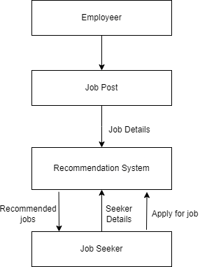
Process model
Data flow diagram
a. Level 0 Data Flow Diagram:

Slide 15
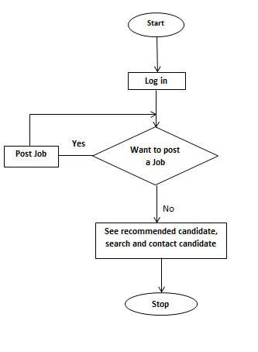
Flow Chart Employer
See job applicant

Slide 16
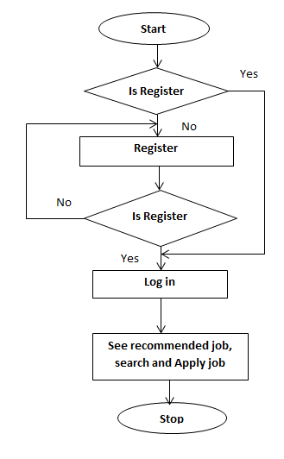
Flow chart of job seekers

Slide 17
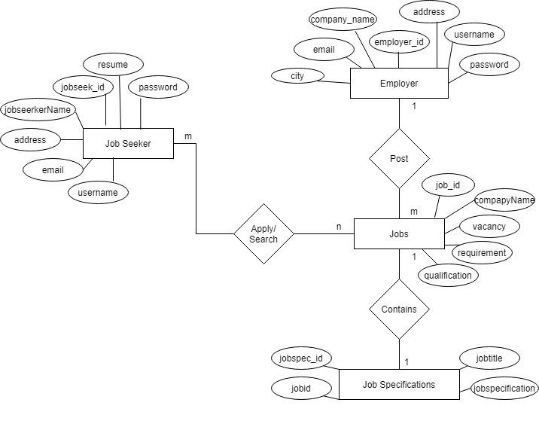
ER Diagram

Slide 18
Implementation tools
1. Frontend
HTML ,
CSS ,
JavaScript
Bootstrap 4
2. Backend:
PHP
3. Database
- mysql

Slide 19
Content-Based Filtering
Cognitive filtering, recommends items based on a comparison between the content of the items and a user profile
The vector space model and latent semantic indexing are two methods that use the terms to represent documents as vectors in a multidimensional space.
A learning algorithm has to be chosen that is able to learn the user profile based on seen items and can make recommendations based on this user profile.

Slide 20

Cosine Similarity Algorithm
Steps to find the cosine similarities
Convert words to vector
Find the cosine angle between the vectors by using the formula as below.
Find the items having the cosine values greater than defined in algorithm.

Slide 21
Testing
Unit testing: each and every components of software are tested.
Integration testing: integrated logically and tested as a group.
System testing: validates the complete and fully integrated software
Text Cases | Preconditions | Step to be executed | Expected Results | Actual Results | Pass/Fail
Log in for Job seeker | The job seeker account should be logged In | Email: nabin@gmail.com Pass: nabin Click logged In | The job seeker must be successfully logged in the System | Job seeker is successfully Logged In. | Pass

Slide 22
Future Improvement
The system can be enhanced for the future by:
Developing mobile apps for the system.
Making the recommendation job on the bases of the current location of the users.
Provides a convenient and efficient platform for job seekers and employers to interact with each other.
The interactive AI chatbot brings an additional touch to the user experience.

Slide 23
Conclusion
Provides a convenient and efficient platform for job seekers and employers to interact with each other
As a result, the system can recommend the job to the job seekers which will reduce the time of searching jobs. Job recommendation web-based application is developed through the use of the PHP. Through the use of this web application Job provider can post the job and people can apply for the job according to the qualification and experience.

Slide 24

Seeking For A Desired Job...☹ Don’t worry! Come And Visit Our Site… Thank You !!! Bsc.CSIT 7th semester

